Slide 1

Ch01. Network Game Overview
Game Server Programming
Notes:
Week01, 1st class

Slide 2
Contents
A Brief history of Multiplayer Games
Local multiplayer game
Early network multiplayer games
MUD: Multi-user dungeons
LAN games
Online games
MMO games
Mobile network games
Case Study: Representative Early Network Games
<Star Siege: Tribes>
Platform Packet Module
Connection Manager
Stream Manager
Event Manager
Ghost Manager
Movement Manager
Other Systems
<Age of Empires>
Turn Timer
Synchronization
Source: Multiplayer game programming, Gilbut, 2017

Slide 3
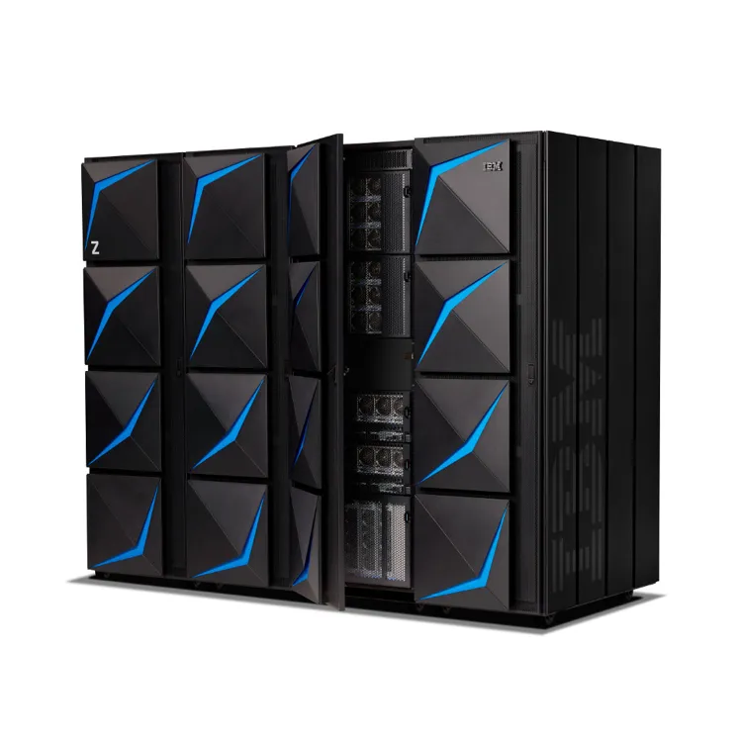
1.1 A Brief History of Multiplayer Games
Origins of Multiplayer Games
1970s introduction of network multiplayer with the advent of university mainframe systems
Popular introduction of multiplayer games
Mid-to-Late1990s
IBM z15 mainframe computer

Slide 4
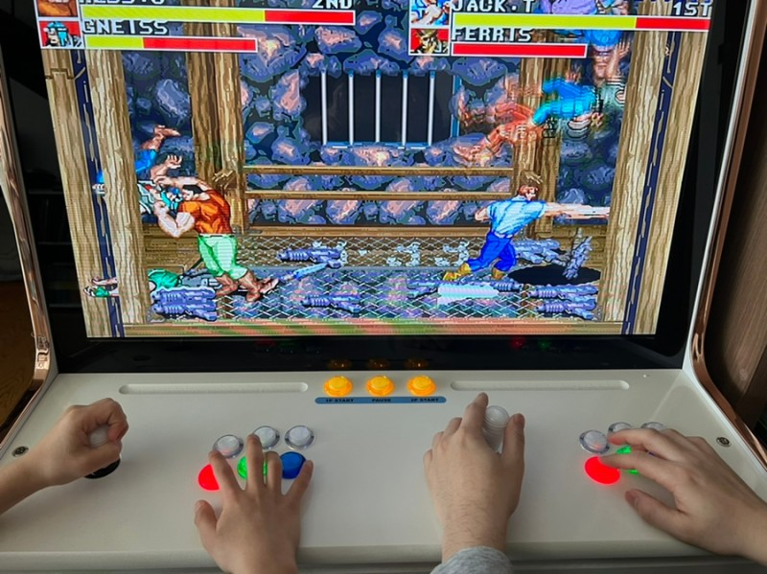
1.1.1 Local multiplayer game
Two or more players on one computer
Almost the same technique as programming a single-player game
Differences:
Showing more than one viewpoint
Handling multiple input devices simultaneously
예시:
Tennis for Two (1958)
https://www.youtube.com/watch?v=6PG2mdU_i8k
Spacewar! (1962)
https://www.youtube.com/watch?v=rLX_AoOinM4
https://www.youtube.com/watch?v=CwZAKJ8Y6YU

Slide 5
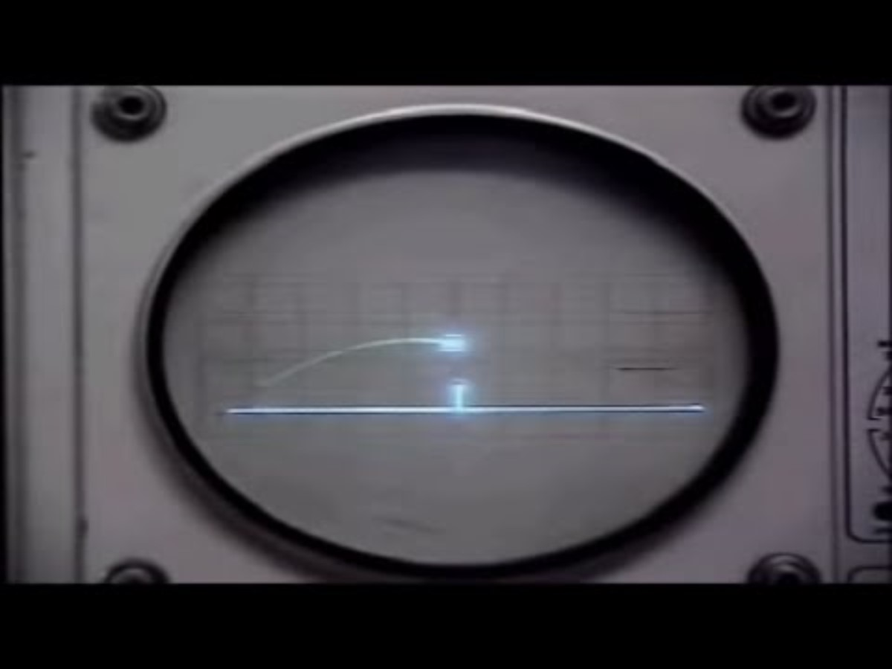
Tennis for Two (1958)

Slide 6
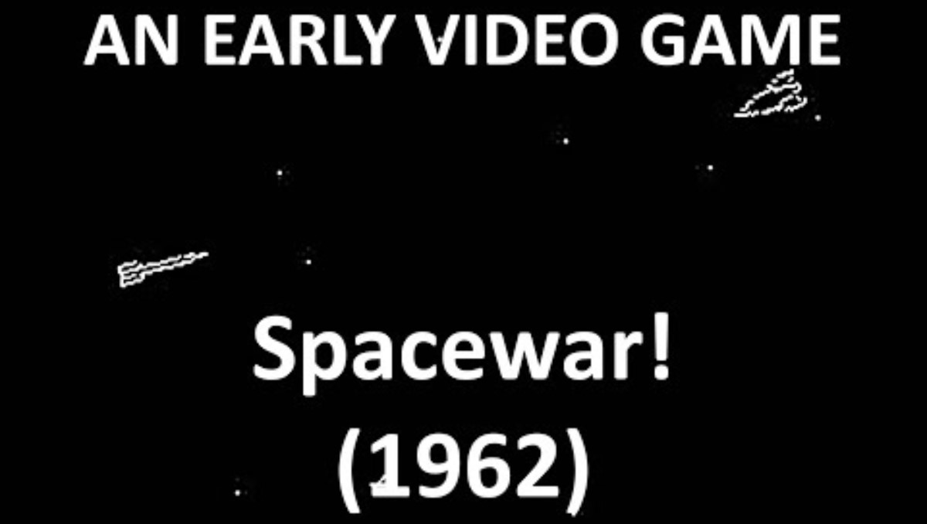
Spacewar! (1962)

Slide 7

Spacewar! (1961) on PDP-1 computer
Programmed Data Processor-1
Notes:
PDP-1 computer

Slide 8
1.1.2 Early network multiplayer games
First appeared on small networks based on mainframes
Different from local multiplayer games:
Two or more computers each connect to form a game session
Examp[les
Empire (1973)
Turn-based strategy game, developed by the University of Illinois and implemented on the PLATO mainframe NW system
https://www.youtube.com/watch?v=lUqVwPFgXO4
Maze War (around the same time)
There is some disagreement as to which of the above games came first
https://www.youtube.com/watch?v=CF9XKRWnsTY

Slide 9
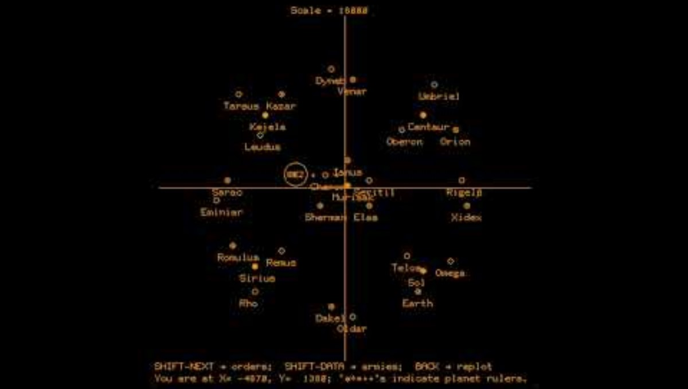
Empire (1973)
Notes:
https://www.youtube.com/watch?v=lUqVwPFgXO4

Slide 10
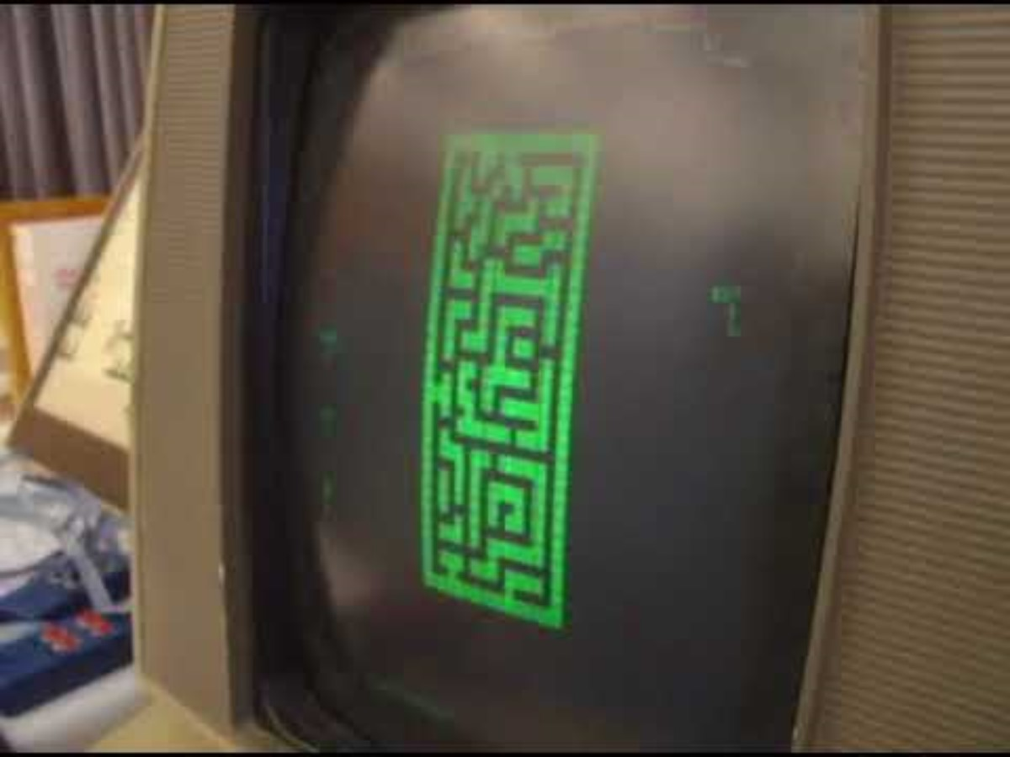
Maze War (1973)

Slide 11
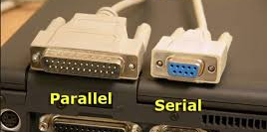
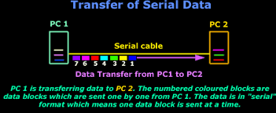
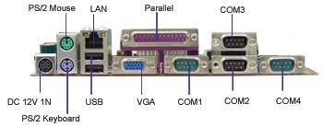
Direct connection between computers using serial ports
PCs began to spread in the 1970s
Serial ports:
Mainly used for communication with peripheral devices such as printers and modems
Data can be transmitted one bit at a time
Game development technology utilizing local networks was possible in the early 1980s
In the 1990s, ideas related to computer-connected game play began to attract attention

Slide 12
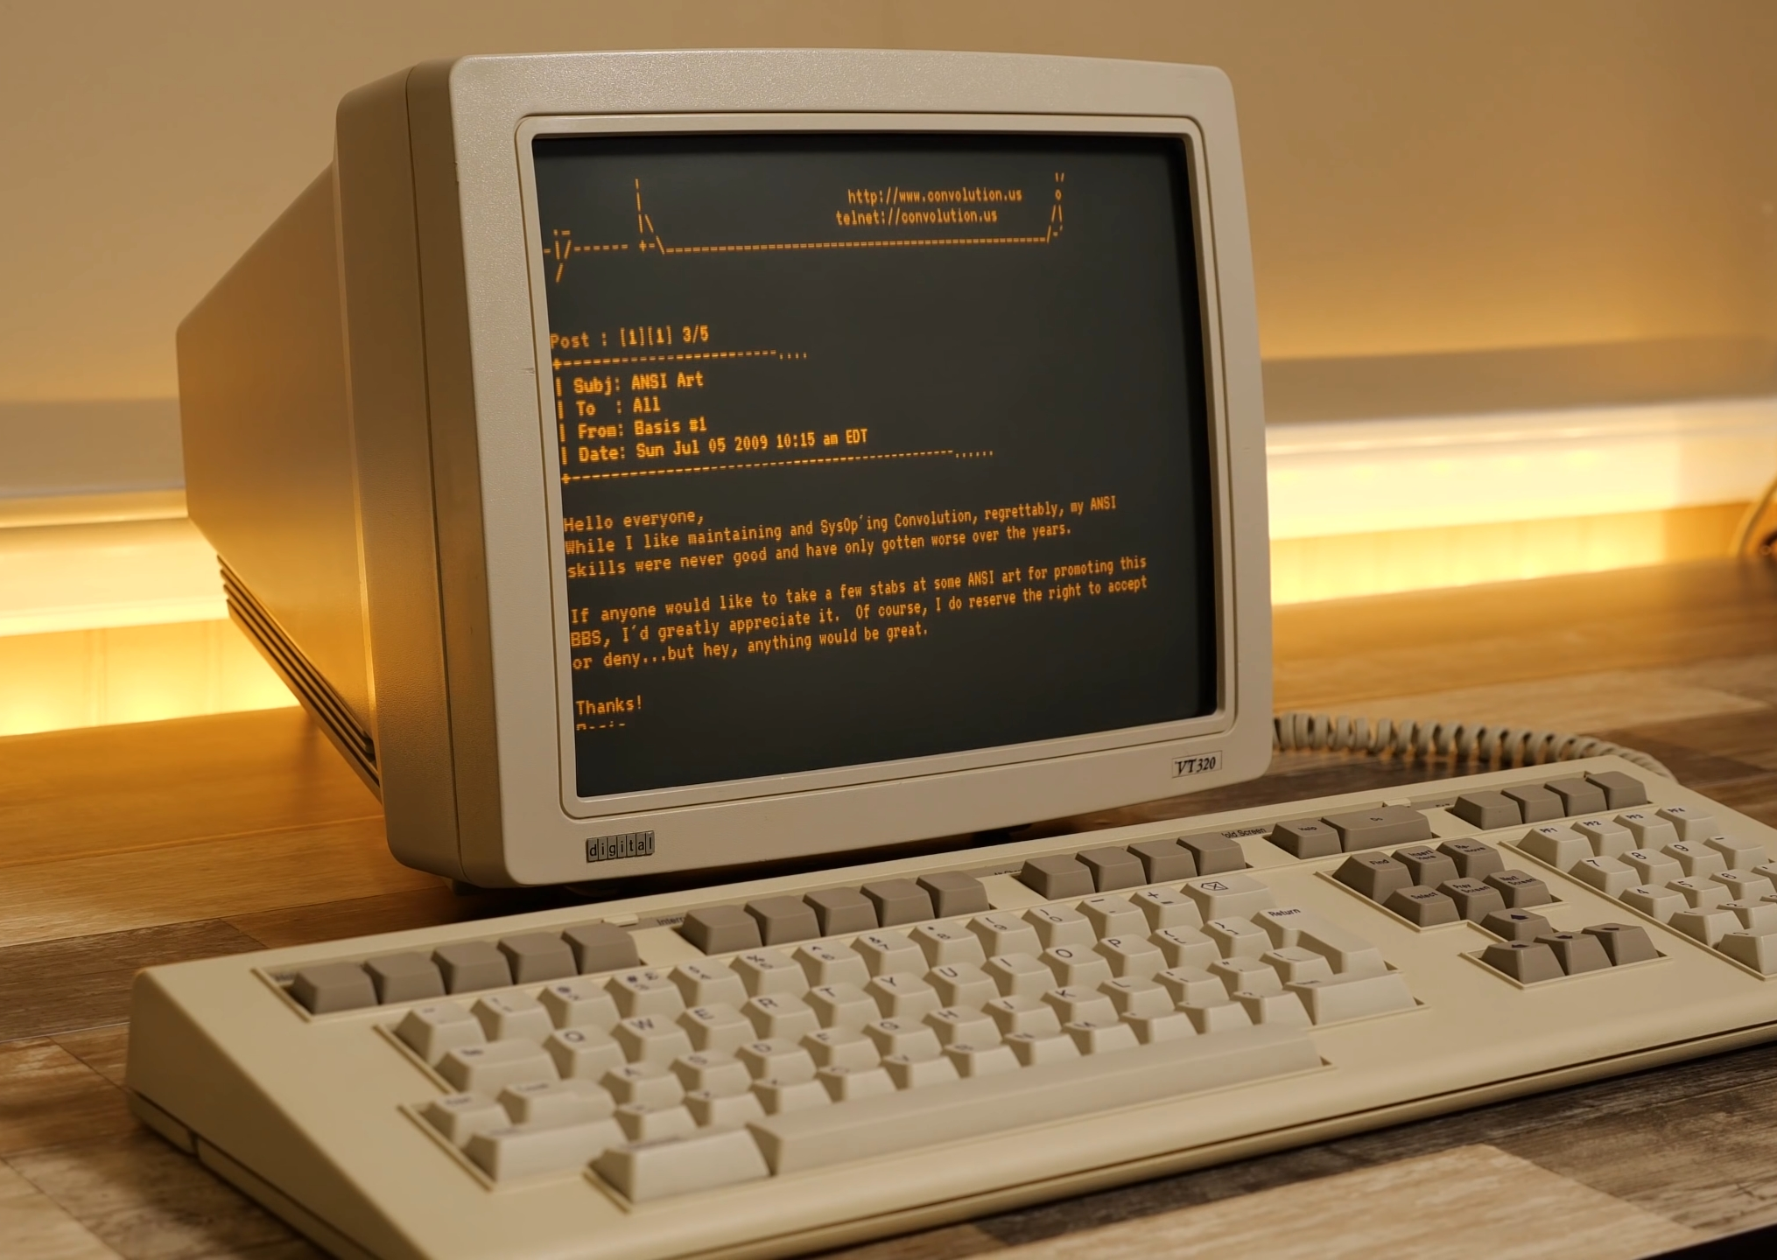
1.1.3 MUD: Multi-User Dungeon
MUD (Multi-User Dungeon)
Usually text-based
Multiple players simultaneously access the same virtual space
Initially popular in university computer labs (computer lab terminal environment)
PC performance enhancement -> Modem installation: Two computers can communicate with each other over a telephone network
MUD1 (1978) - First MUD game:
https://www.youtube.com/watch?v=9Gep3LwLKWk

Slide 13
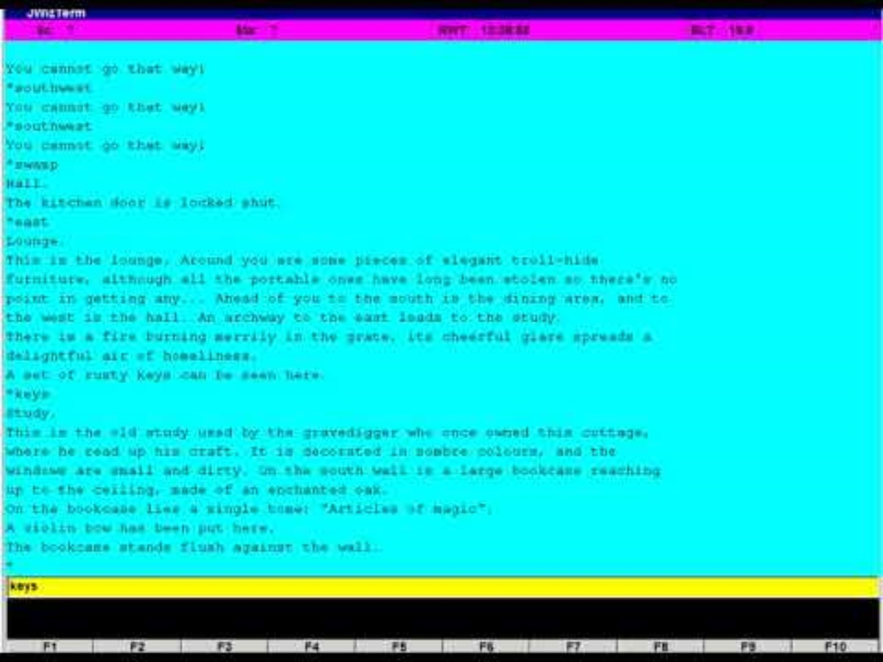
MUD1 (1978)

Slide 14
1.1.4 LAN Game
LAN(Local Area Network): A network of computers connected to each other within a relatively close area
There are various local area network technologies, but basically it means an Ethernet network
Example:
Doom (1993):
ID Software
FPS(First Person Shooting)
Up to four people can connect per session in the early versions (cooperative mode, competitive mode Death Match)
Had a great influence on the gaming industry today. A pioneer of modern network games
https://www.youtube.com/watch?v=MnqLJpgq7jc

Slide 15
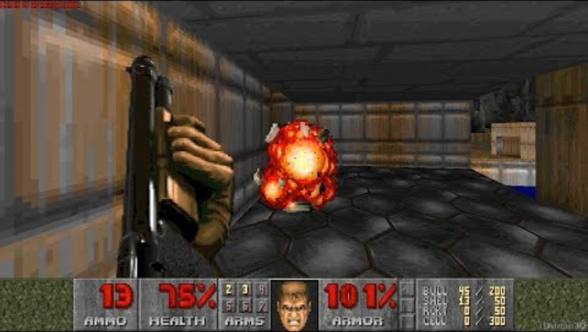
Doom (1993)

Slide 16
1.1.5 Online game
Online games
Games played by connecting geographically distant computers through a large communication network
All types of communication networks including the Internet (ex. Telephone switch network)
Examples:
Quake (1996, ID Software) https://www.youtube.com/watch?v=MkED3x0TjYU
Unreal (1998, Epic Games) https://www.youtube.com/watch?v=yEVNbYhHZT0
Differences from LAN-based games
Latency: Time delay that occurs when transmitting data
Based on the explosive popularization of the Internet in the 90s
Notes:
In the true sense of...

Slide 17
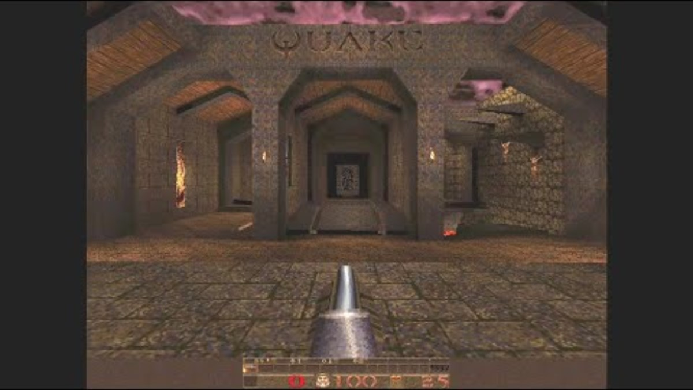
Quake (1996, ID Software)

Slide 18
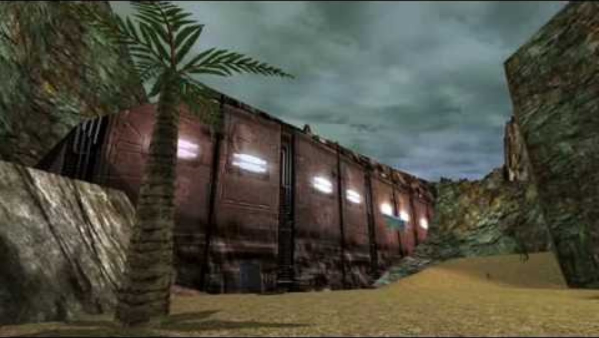
Unreal (1998, Epic Games)
Notes:
https://www.youtube.com/watch?v=yEVNbYhHZT0

Slide 19
1.1.6 MMO Game
MMO(Massively Multiplayer Online)
Hundreds, thousands, and tens of thousands of players can participate in a single game at the same time
Since MMOs are usually RPGs, the name MMORPG is familiar
MMOFPS games also exist
MUD games evolve into graphic forms
Examples
Habitat (1986): Introducing various new technologies
https://www.youtube.com/watch?v=1yia3-foHLE
https://www.researchgate.net/publication/243708892_The_Lessons_of_Lucasfilm''s_Habitat
Ultima Online (1997): Gaining full attention Internet Spreading Aftermath
https://www.youtube.com/watch?v=vzawLtaQ5Ls
World of Warcraft (2004, Blizzard): A Pop Culture Icon in Itself
https://www.youtube.com/watch?v=1q0f4KtEiZ8
https://www.southparkstudios.com/episodes/hk2x6r/south-park-make-love-not-warcraft-season-10-ep-8
There Are Many Highly Technical Challenges in Designing

Slide 20
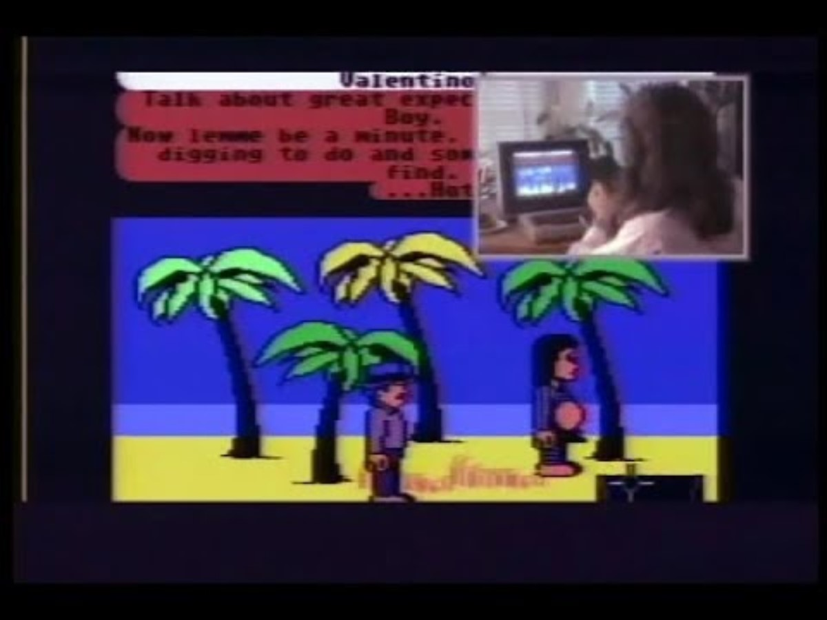
Habitat (1986)

Slide 21
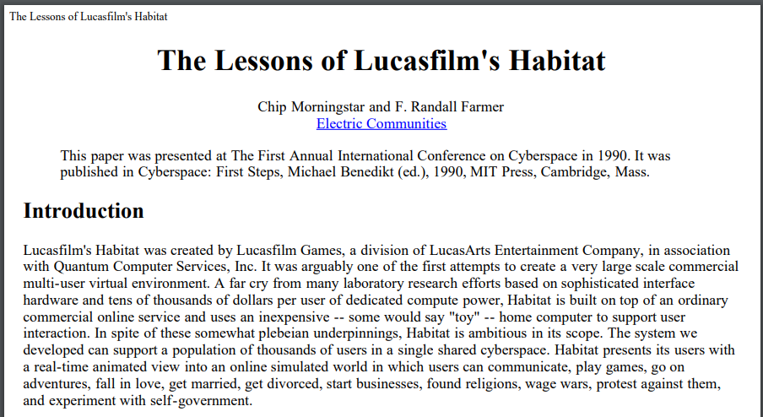

Slide 22
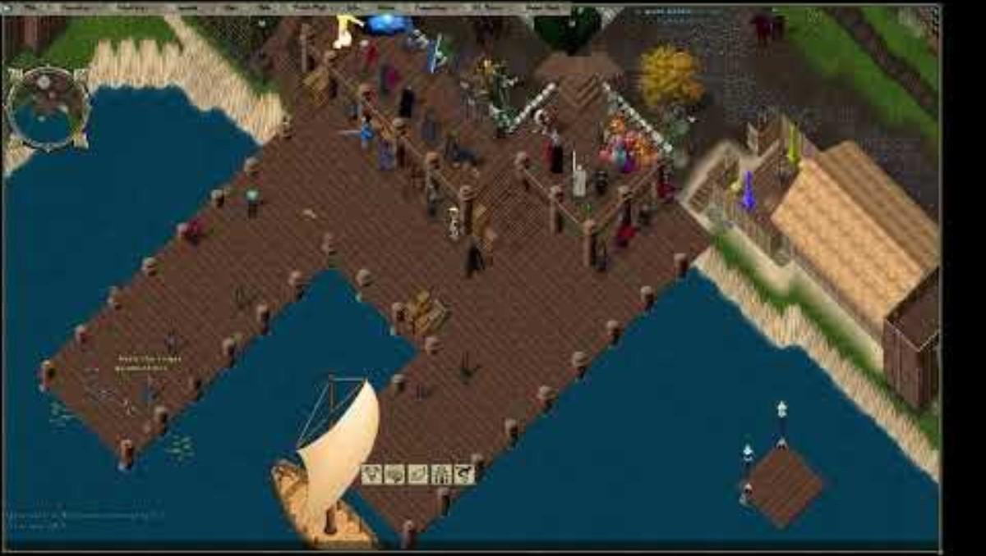
Ultima Online (1997)

Slide 23
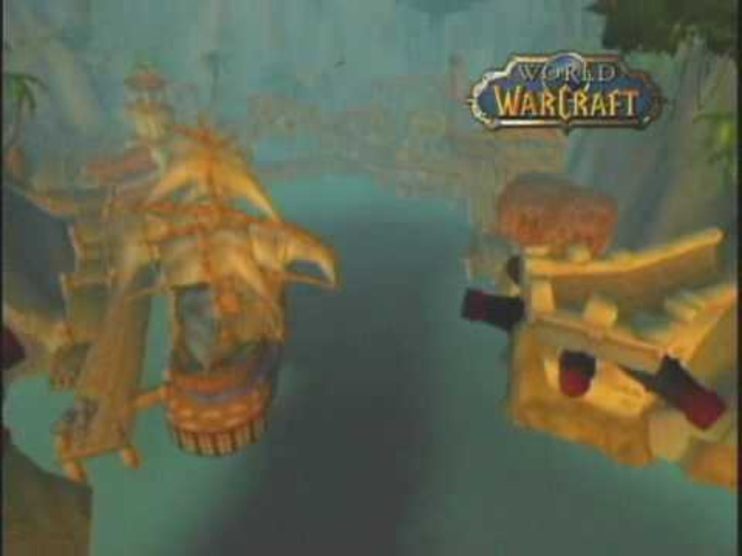
World of Warcraft (2004, Blizzard)
Notes:
World of Warcraft - E3 2003 Trailer
https://www.youtube.com/watch?v=1q0f4KtEiZ8

Slide 24

1.1.7 Mobile Network Game
Mobile device-based multiplayer games spread due to the popularization of mobile devices
Usually implemented asynchronously in the past
No need to transmit data in real time
Easier to implement than real-time network games. Communication method provided by platform API.
When it is a player's turn, a notification appears, and the player has ample time to play his turn.
Example
Words with Friends (2009) https://www.youtube.com/watch?v=b197RnHhhJs
Mobile network development (wifi, etc.)
Real-time network support games appear one after another
Example
Hearthstone: Heroes of Warcraft (2014)
https://www.youtube.com/watch?v=kBNGJRF06ck

Slide 25

Words with Friends (2009)
Notes:
https://www.youtube.com/watch?v=b197RnHhhJs

Slide 26
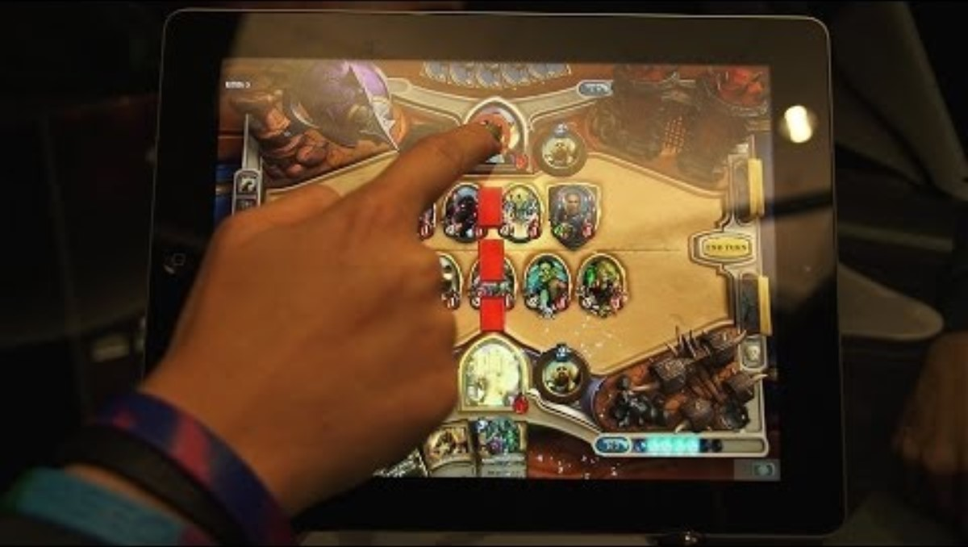
Hearthstone: Heroes of Warcraft (2014)

Slide 27
1.2 <Starsiege: Tribes>
Starsiege: Tribes
SF genre FPS released in late 1998
Fast-paced battle
Supported large number of users at the time (up to 128 people)
Users using 28.8kbps modems can also play
https://www.youtube.com/watch?v=HiiWWD9FkN0
The network model used in this game is still largely useful!

Slide 28

Starsiege Tribes

Slide 29
Tribes’ Four Data Transmission Methods
Non-guaranteed data
Guaranteed data
Reception must be guaranteed, and it is also guaranteed to arrive in the order it was sent. Very important data for the game. Example: Player bullet firing event
Most recent state
Data that is meaningless to transmit if it is not up to date. Example: A specific player's health value. If you know their current HP, you don't necessarily need to know what their HP was 5 seconds ago.
Refers to data that is not very important to the game. When bandwidth is exhausted, this type of data is skipped first.
Guaranteed quickest
Data that must be sent with the highest priority and also guaranteed to be delivered. Example: Player location information. The value of information decreases rapidly as time passes, so it must be transmitted as quickly as possible.

Slide 30
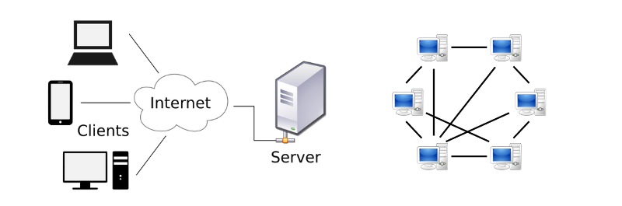
Choosing a Client-Server Networking Model
Adopting the Client-Server (CS) model instead of the Peer-to-Peer (P2P) model
P2P: Each player connects 1:1 with all other players
Requires O(n²) bandwidth: Bandwidth consumption is proportional to the square of the number of users
CS: All players connect to one central server
Requires O(n) bandwidth. Adopting the CS model to solve the bandwidth problem above
The server must be able to accept all clients

Slide 31
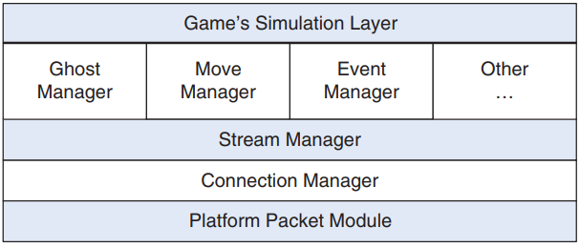
Key Components of the <Tribes> Networking Model
Notes:
고스트관리자, 이동관리자, 이벤트관리자
스트림관리자
연결관리자
플렛폼 패킷 모듈

Slide 32
1.2.1 Platform Packet Module
The lowest layer, the only platform-dependent layer
Essentially wrapping the standard socket API
Purpose is to assemble and transmit various packet formats
Packet: A unit of data bundled for sending over a network

Slide 33
1.2.2 Connection Manager
Abstracts the connection between two computers
Receives data sent by the stream manager on the upper layer and delivers it to the lower layer (platform packet module)
Does not guarantee reliability (does not take responsibility for delivering data)
The connection manager only clearly informs whether the packet has been delivered
DSN(Delivery Status Notification)
The upper layer (stream manager) uses it to determine whether specific data has been delivered safely

Slide 34
1.2.3 Stream Manager
Sends data to the connection manager on behalf of other higher level managers
Controls the maximum allowed transfer rate
To prevent the server from being overloaded by sending too much data
Example: 28.8kbps modem: 10 packets per second, 200 bytes per packet --> 2KB/s transfer rate
Prioritizes data transfer requests
Requests from move, event, and ghost managers are given the highest priority
Informs higher level managers whether to send data
The stream manager determines the transfer period and packet size
Often mixes different types of data in a single packet

Slide 35
1.2.4 Event Manager
Manage the queue of events that occur during game simulation
These events are a kind of simple RPC (Remote Procedure Call)
RPC: A function/procedure that is executed on a remote machine when called
Tracking event transmission history -> Ensuring reliable delivery of events

Slide 36
1.2.5 Ghost Manager
At a high level, the Ghost Manager's job is to replicate or 'ghost' copies of dynamic objects that are deemed meaningful to a particular client.
The various object information that the client receives from the server is called a 'ghost' of the server object on the client.
The Ghost Manager's role is to send/receive these ghosts.
When sending object information to the client, the Ghost Manager filters and sends only the information that is necessary.
The game simulation layer is responsible for judging the information -> assigning a unique priority to the object.
After calculating the priority, the Ghost Manager's role is to send as much object state as possible from the server to the client.
Ensuring that all clients are updated to the latest state is an important responsibility of the Ghost Manager.
The most important system for realizing multiplayer with 128 users

Slide 37
1.2.6 Move Manager
The role of transmitting the player's movement data as quickly as possible
Latency must be minimized to update the movement information quickly enough that the player does not feel any delay
If input data is generated at a speed of 30 frames per second -> 30 inputs are accumulated per second -> The most recent information among them must be sent as quickly as possible
To transmit movement data, the stream manager inserts the movement data in front of the packet to be sent first
Each client move manager transmits data to the server like this
The server reflects the received information in the game simulation and confirms it with the client

Slide 38
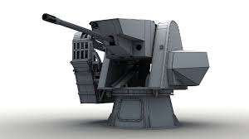
1.2.7 Other systems
<Tribes> has a few other systems, but they are relatively not important in terms of overall weight.
Example: Datablock manager: Handles the transfer of relatively static game objects.
Example of static objects.
Turret: An object that does not actually move, so it is not classified as a dynamic object, but an object whose state is updated when the player interacts with it.
More dynamic objects are handled by the Ghost Manager.
Notes:
<트라이브스> 네트워킹 모델의 주요 구성 요소

Slide 39
1.3 <Age of Empires>
Age of Empires
RTS(Real-Time Strategy), 1997
https://www.youtube.com/watch?v=MoHdOSuyovY
Bandwidth issues and latency issues of Internet dial-up →
Deterministic lockstep model adopted
A method in which one computer connects to all other computers in a peer-to-peer manner
Using lockstep to synchronize all peers while the game is in progress

Slide 40
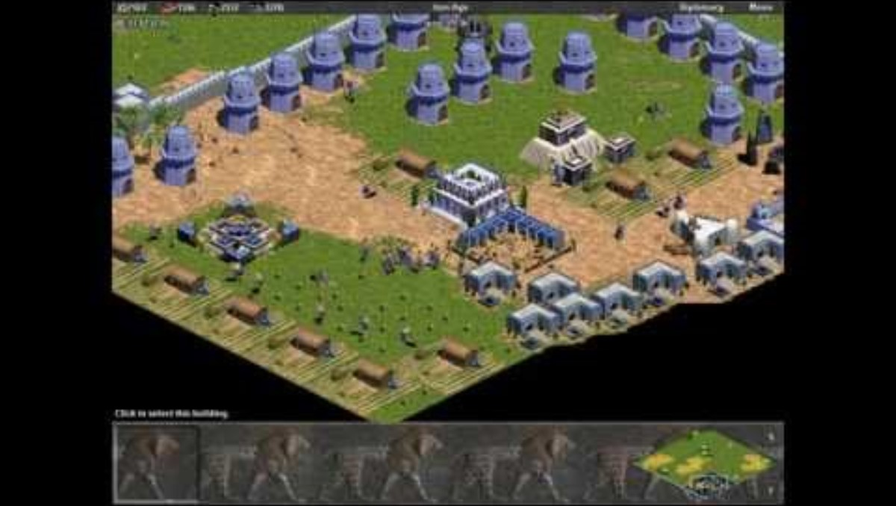
Age of Empires
Notes:
https://www.youtube.com/watch?v=MoHdOSuyovY

Slide 41
Differences between RTS and FPS
The difference in the number of units included in the player's field of vision
RTS: many
FPS: relatively few (in the case of Tribes, when 128 people play, the maximum number of ghosts that the Ghost Manager can handle at once is about 30
Problem: Assuming 8 players playing Age of Empires at the same time
Each player can initially produce 50 units → later, a maximum of 200 units are produced
In the worst case, if 8 players fight in one place using all the units they have accumulated, 200 units x 8 people = 1600 units

Slide 42
Many unit synchronization solutions
Instead of unit-by-unit synchronization, synchronize player-entered commands
Players only need to generate and transmit a few commands per second at most
Much easier to manage bandwidth than sending hundreds of units of information
Each player's game instance simulates based on the commands sent
Since each player's simulation is performed independently, it becomes extremely important that each instance can be synchronized exactly with the others
The most difficult task in implementing a deterministic lockstep model!

Slide 43
Deterministic lockstep model
Deterministic lockstep models require very accurate synchronization, but can suffer from synchronization problems due to various factors such as network conditions, hardware performance, and software bugs. To prevent this, games often try to maintain synchronization using methods such as 'command queues' or 'state verification’.
All clients are guaranteed to compute the same results when they receive the same command from the same initial state, but if synchronization is not achieved, various problems can occur.

Slide 44
When the deterministic lockstep model fails
Command Loss or Delay: If a player's command does not arrive on time due to network latency or packet loss, the game may freeze or command processing may be incorrect. If a player's command is not propagated properly, other players' clients may end up in different states.
Incorrect Time Synchronization: All players must execute commands at exactly the same time, but if there is a time difference between clients, one player may be slightly ahead or behind the other. This can cause one player to have an advantage or disadvantage in certain situations.
Failure of Random Number Synchronization: Deterministic models are designed to ensure that all clients use the same random seed to obtain the same results, but if the random number generation behaves differently across clients, this can lead to synchronization problems. For example, random-based events (such as the critical hit probability of an attack) may occur differently for each player.

Slide 45
When the deterministic lockstep model fails
Inconsistencies with other client states: If one client processes an incorrect command or is in a state that does not match the state of another client at a certain point in time, a game state inconsistency can occur. This often leads to an unrecoverable state, eventually resulting in a phenomenon called "desync."
Incorrect command ordering: Problems arise when each client processes commands in a different order. In a deterministic model, commands must be executed in the correct order to achieve the same result, so a different command order can result in a different game state.

Slide 46
1.3.1 Turn timer
Each game instance runs a simulation independently
P2P topology is well suited
Advantage: Data can be transmitted relatively quickly (because it does not go through the server)
Disadvantage: Transmission required to all peers
Problem
Each player operates at a different frame rate, and has a different connection quality
Delay occurs when waiting for everyone to respond
Solution→Add a turn timer: Stack commands at regular intervals

Slide 47
Length of turn
In the case of <Age of Empires>, the length of the turn is 200 milliseconds.
During that period, all commands are queued in the queue buffer.
When the turn is completed, the queued commands are sent to the other player.
The receiving side does not process them immediately, but processes them after two turns.
Example:
In the case of a 200 millisecond timer, the input lag and the delay time after inputting the screen are combined to a maximum of 600 milliseconds (200: waiting for the player sending the command, 200*2=400: waiting for the receiving side).

Slide 48
Maginot Line in turn timer mode
If a player experiences severe lag (cannot even keep up with the 200 millisecond timer)
(some games) pause the simulation for a while to give them a chance to overcome the lag.
Continuous lag causes the player to be kicked out.
<age of empires> dynamically adjusts the rendering frame rate. This means that computers with slow Internet connections spend more time receiving, which reduces the quality of the graphics rendering
Rendering Frame Rate: An indicator of how many frames the computer draws on the screen per second (FPS, Frames Per Second)

Slide 49
Advantages of the method of sending commands in batches
Less memory capacity or processing burden
→ In <Age of Empires II>, a game progress replay saving function was added
If unit information was stored one by one instead of commands, much more memory would be required and overhead would be severe

Slide 50
1.3.2 Synchronization
It is difficult to guarantee 100% synchronization between peers with just a turn timer
Possibility of accumulating small errors between peers
Example:
Deer locations placed on a randomly generated map
Accumulation of small errors - Deer locations are not the same after a few minutes - Even if you throw a spear at each peer, peers will miss it by a narrow margin - Chain reactions such as failure to secure food
Note: Pseudo-random number generation
Even if the game is simulated independently, the same random number is generated as long as the seed is the same (must be called the same number of times)
Advantage of synchronization: It becomes difficult for the opponent to use cheat keys
Disadvantage of synchronization: The opponent can steal information that should not be shown (map hack)

Slide 51
Review Qeustions
What is the difference between local multiplayer games and network multiplayer games?
What are three examples of local network connections?
What should primarily be considered when making a game that operates on a LAN also work on the Internet?
What is a mud game and what genre will it evolve into in the future?
What distinguishes an MMO game from a typical online game?
What are the systems that ensure reliability in the <Tribes> model?
Explain how the <Tribes> ghost manager retries transmission with minimal actions when a packet is dropped.
Why does the P2P model of <Age of Empires> use a turn timer? What information is passed to other peers on the network?

Slide 52
[EoF]

